Slide 1

NotePad
EN9874 Project
Instructor: Dr. Mohamed Shehata
XiaoFei Wang
Aodan Xin

Slide 2
Outline
Description
Implementation
Design Pattern
Problem Solved
Further Work

Slide 3
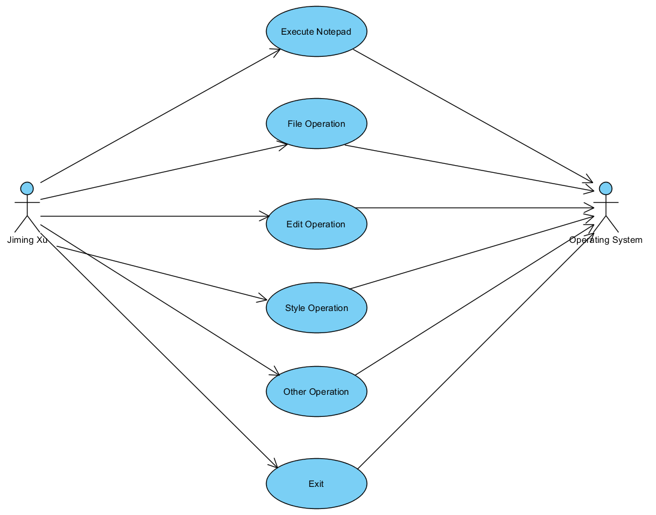
Description

Slide 4
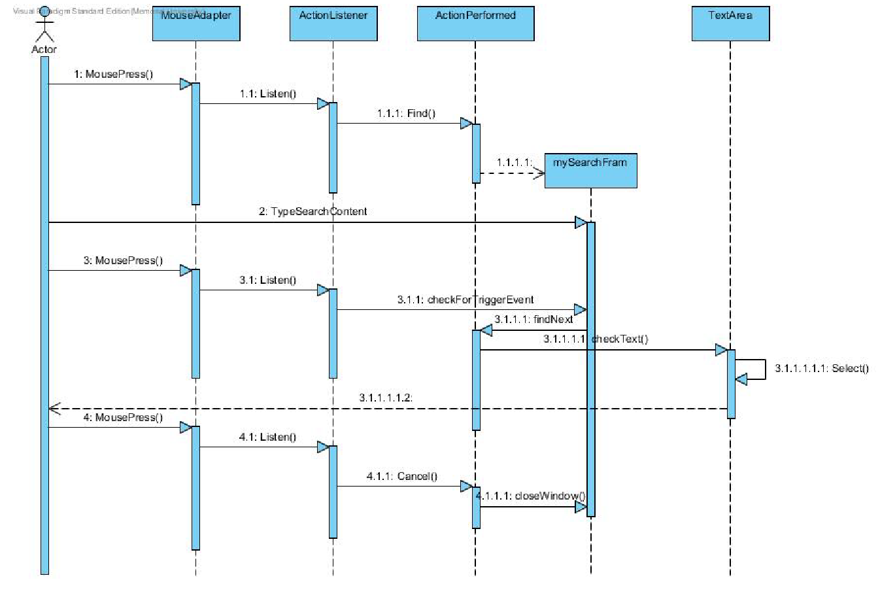
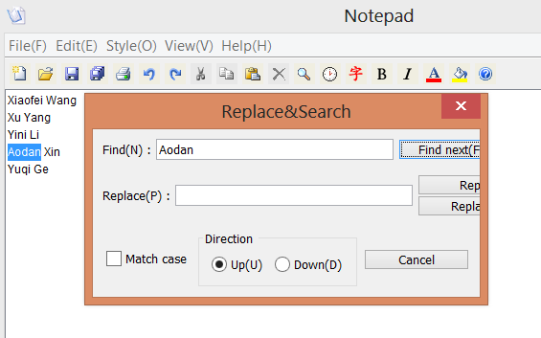
Implementation

Slide 5
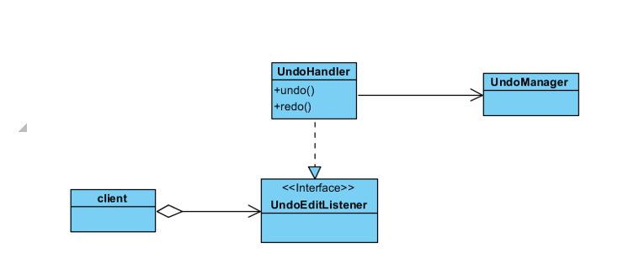
Command Pattern

Slide 6
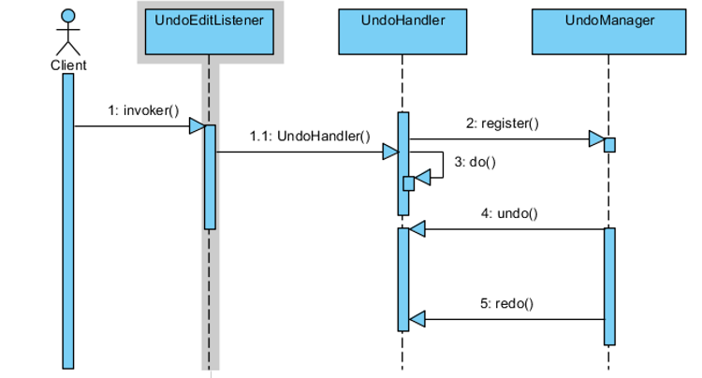
Command Pattern (Cont.)

Slide 7
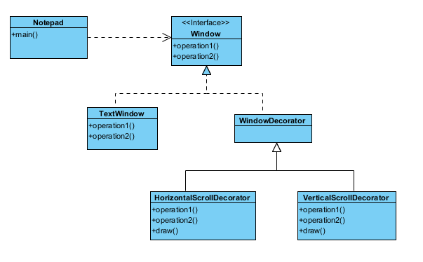
Decorator Pattern

Slide 8
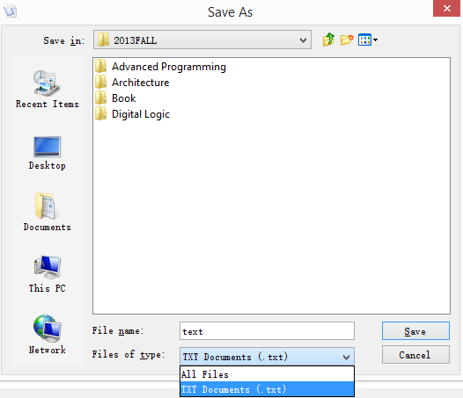
Problem Solved
Problem : how to restrict the file type
Solution: use the "FileFilter"

Slide 9
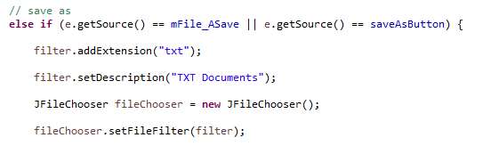
Problem Solved (Cont.)
java.lang.Object
javax.swing.filechooser.FileFilter
javax.swing.filechooser.FileNameExtenionFilter
public final class FileNameExtensionFilter
extends FileFilter

Slide 10
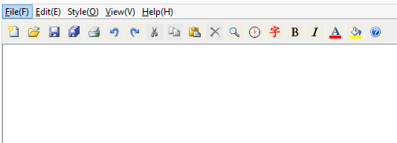

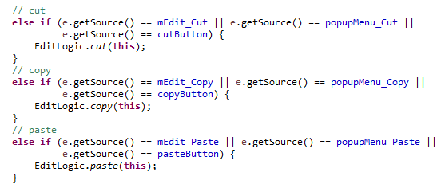
Problem Solved (Cont.)

Slide 11
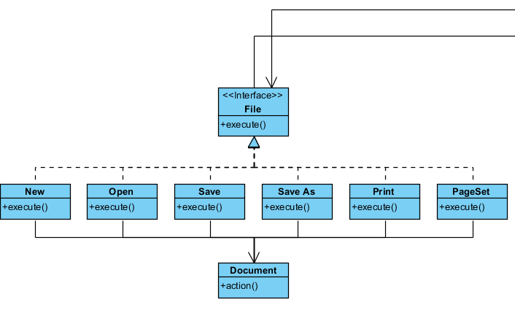
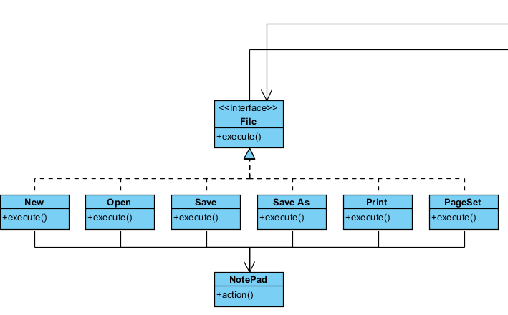
Further Work

Slide 12
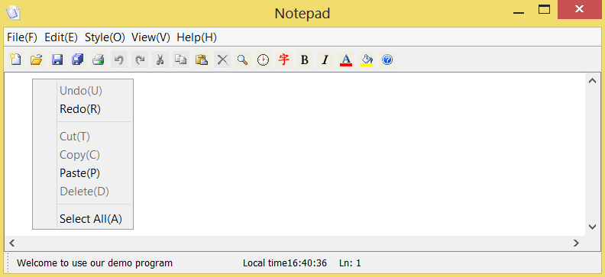
Further Work (Cont.)

Slide 13
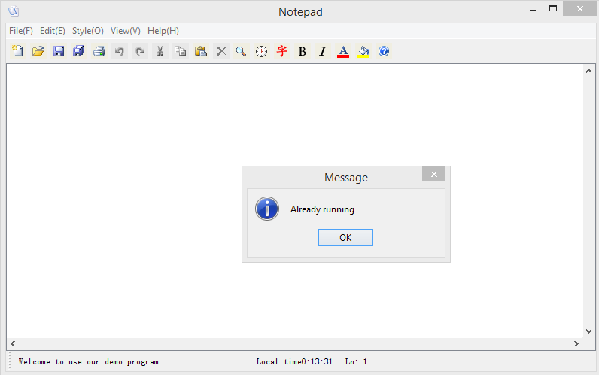
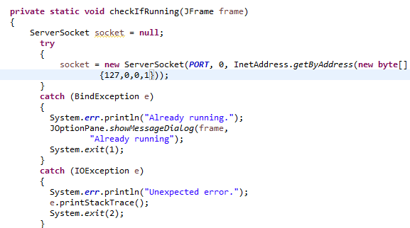
Further Work (Cont.)
Current design:

Slide 14
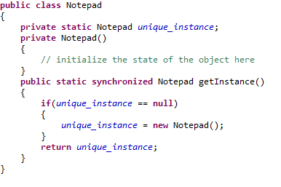
Further Work (Cont.)
Good design: Use the singleton pattern
Example:

Slide 15
Thank you
Any Questions?

